Slide 1
Athena & Glue
Jason Poley
Distinguished Engineer

Slide 2
DATA

Slide 3
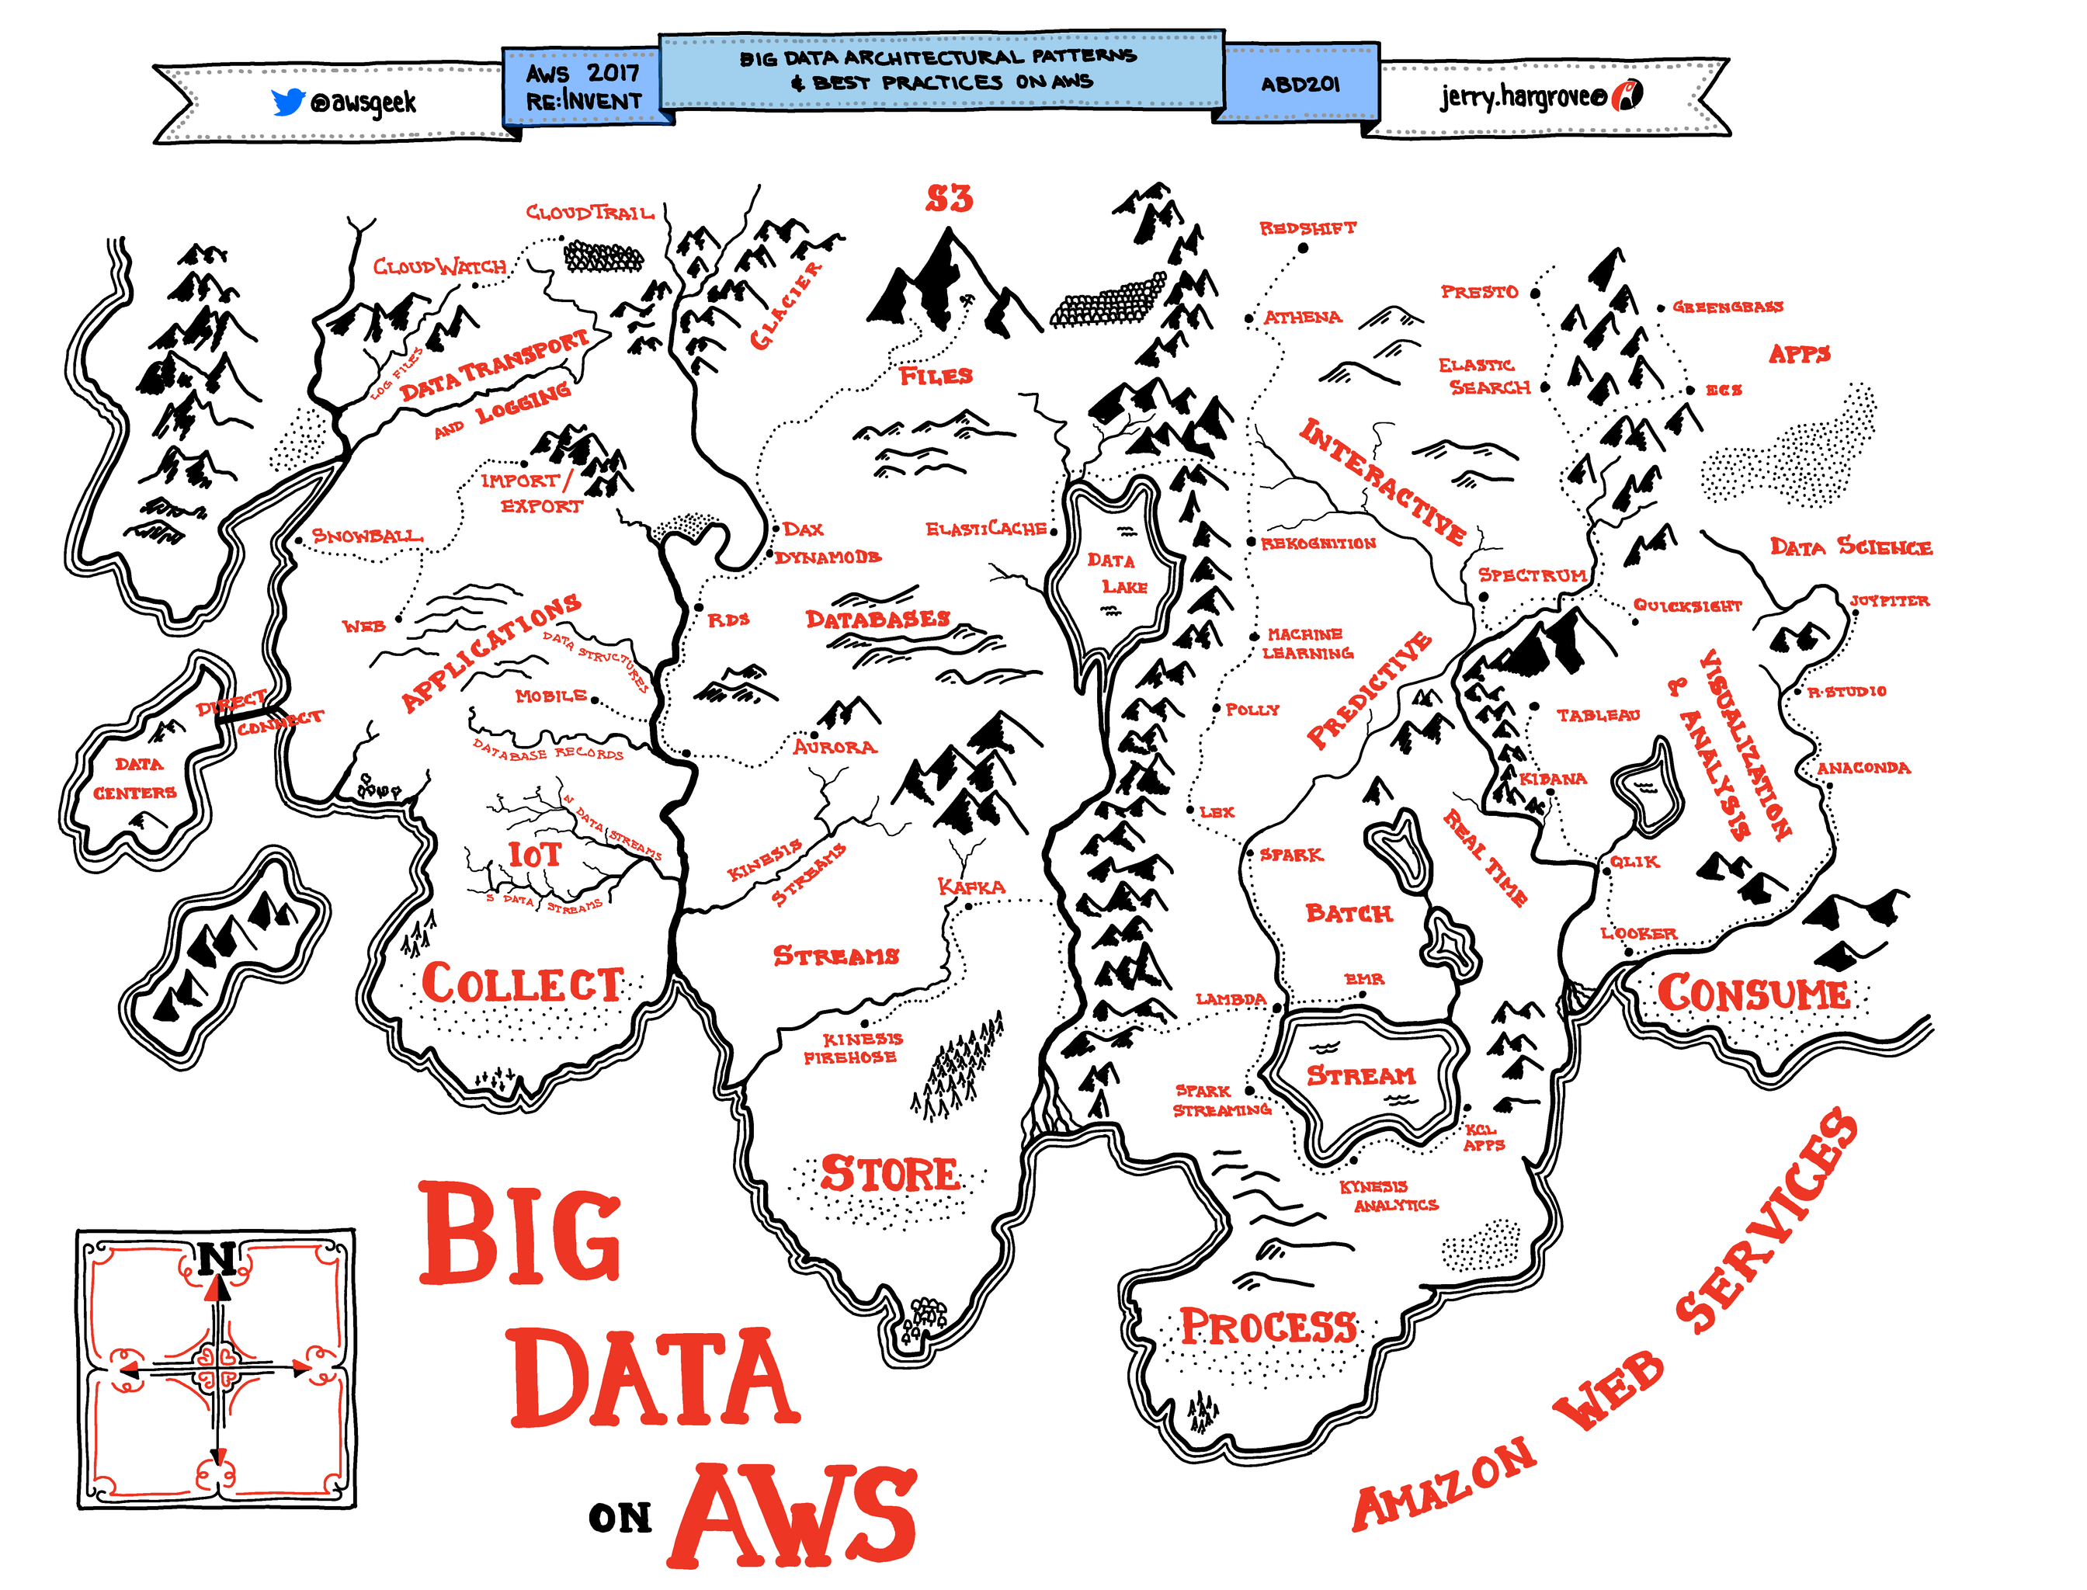

Slide 4
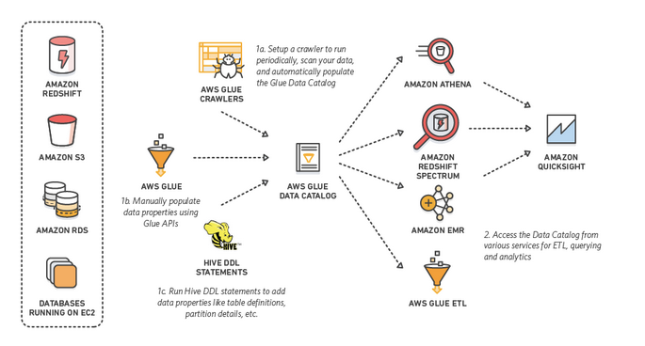
Glue & Athena

Slide 5
Data in AWS
Streaming Data
Databases / Warehouse
Lake Formation
Data Pipeline
Database Migration Service
Files
RDS
Timestream
Kinesis
Managed Streaming for Kafka
DynamoDB
DocumentDB
EFS
S3
Neptune
QLDB
Amazon Redshift
Amazon Elastic Block Store (EBS)
Amazon FSx

Slide 6
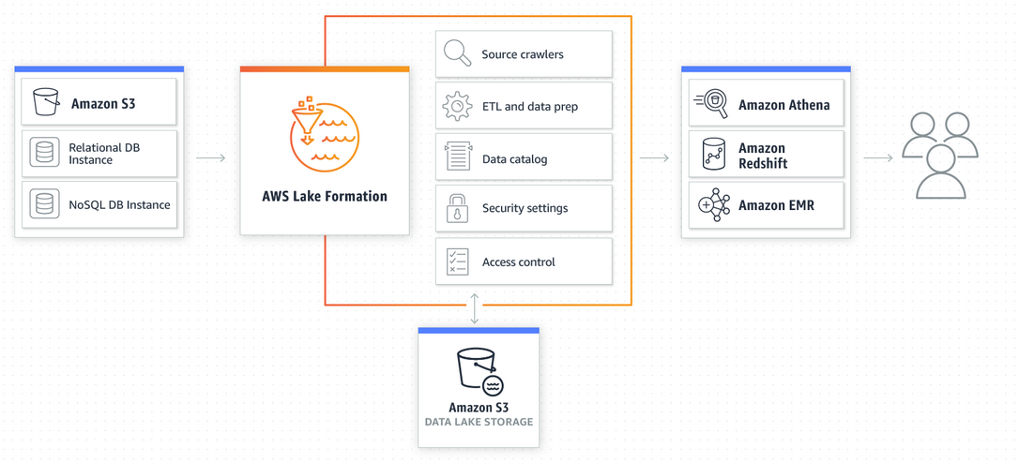
Lake Formation

Slide 7
Serverless Data Transformation
Pay for only what you use (storage / data transfer separate)
Crawl data (ad-hoc or scheduled)
Query data that’s Unstructured, Semi Structured or Structured.
Catalog data into a metastore (much like Hive)
Can Connect to JDBC/ODBC datasource or S3
Outputs to tooling like SageMaker, QuickSight, RedShift, S3, RDS
Can use 3rd party Analytics tooling

Slide 8
Compliance & Security
Athena & Glue are SOC 1,2,3 compliant as well as PCI, HIPPA & FedRAMP compliant.
Encryption @Rest
Encryption in flight
Fine Grained IAM Permissions
Workgroups
Security on Glue Data Catalog

Slide 9
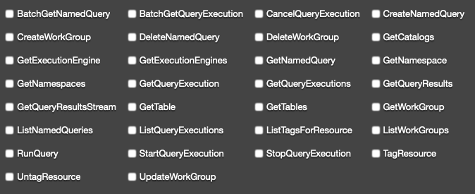
Athena IAM Policy

Slide 10
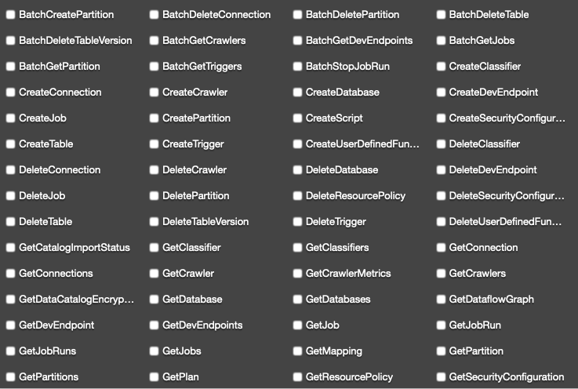
Glue IAM Policy

Slide 11
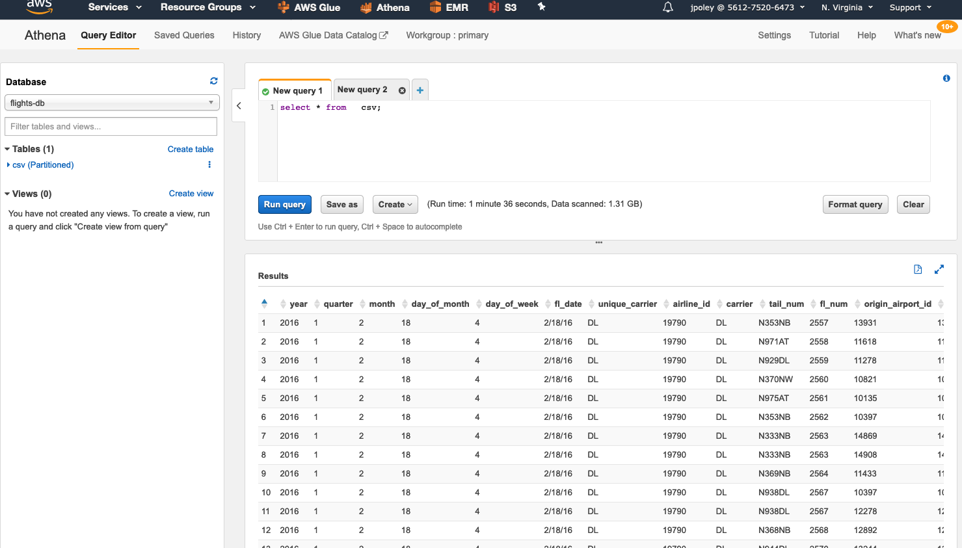
Athena
Serverless Query (SQL) on top of S3.

Slide 12
http://prestodb.github.io/
Presto is an open source distributed SQL query engine for running interactive analytic queries against data sources of all sizes ranging from gigabytes to petabytes.
Presto was designed and written from the ground up for interactive analytics and approaches the speed of commercial data warehouses while scaling to the size of organizations like Facebook.

Slide 13
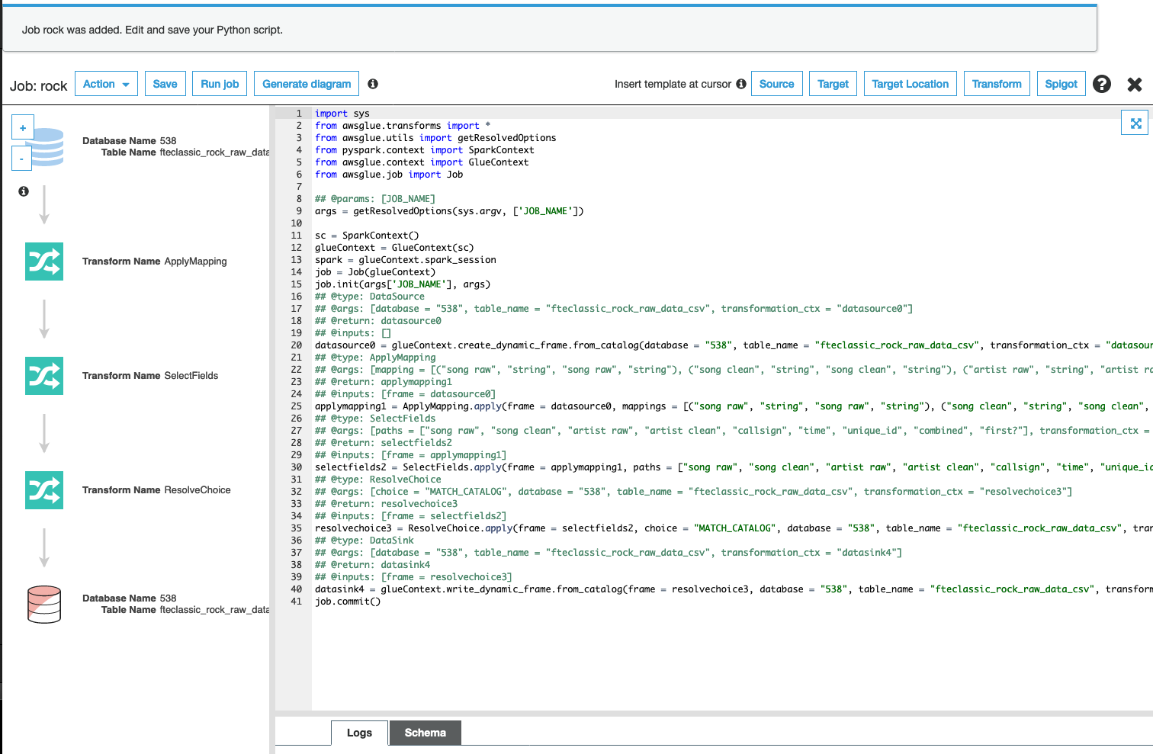
Glue
Triggers
Crawlers
Jobs
Connections

Slide 14
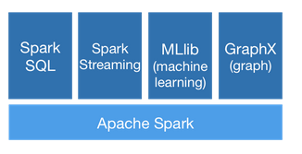
https://spark.apache.org/
Spark is a general-purpose distributed data processing engine that is suitable for use in a wide range of circumstances.
On top of the Spark core data processing engine, there are libraries for SQL, machine learning, graph computation, and stream processing, which can be used together in an application.
Code Written in Python / Scala (AWS)

Slide 15
Glue - Pros & Cons
Pros
Simple & Serverless
Lots of Integrations
Security Model
Fast to get started
Pay for Usage
Cons
Versioning
Vertical Autoscaling
Only supports python 2

Slide 16
Athena – Pros & Cons
Pros
Simple & Serverless
Pay for Usage
Rapid Prototyping
Cheaper Storage
Cons
No support for custom SerDes
No support for custom Functions

Slide 17
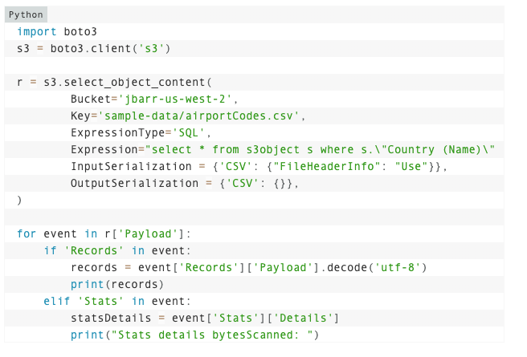
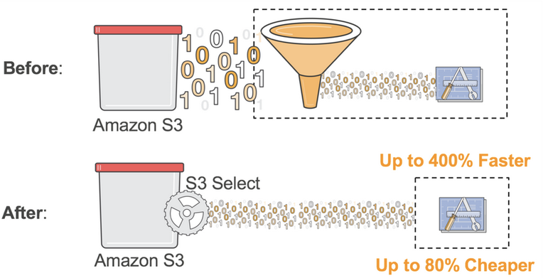
S3 & Glacier Select
https://aws.amazon.com/blogs/aws/s3-glacier-select/
enables applications to retrieve only a subset of data from an object by using simple SQL expressions. By using S3 Select to retrieve only the data needed by your application, you can achieve drastic performance increases – in many cases you can get as much as a 400% improvement.

Slide 18
Athena Pricing

Slide 19
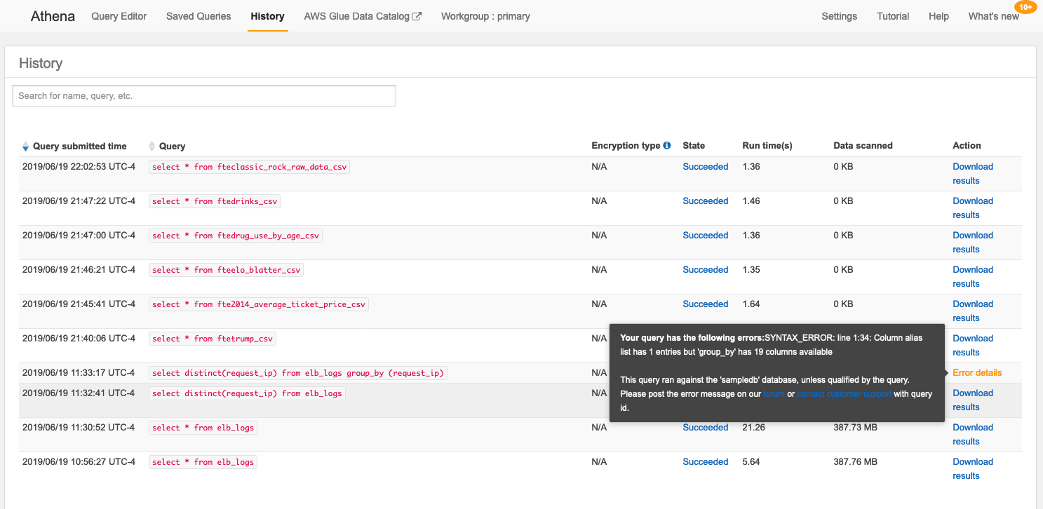
Athena History

Slide 20
Glue Pricing
$0.44 per DPU-Hour, billed per second, with a 10-minute minimum for each ETL job of type Apache Spark
$0.44 per DPU-Hour, billed per second, with a 1-minute minimum for each ETL job of type Python shell
$0.44 per DPU-Hour, billed per second, with a 10-minute minimum for each provisioned development endpoint
DPU = Data Processing Unit = 4 vCPU & 16 GB Memory
Spark requires 2 DPU where Python Shell can run on less

Slide 21
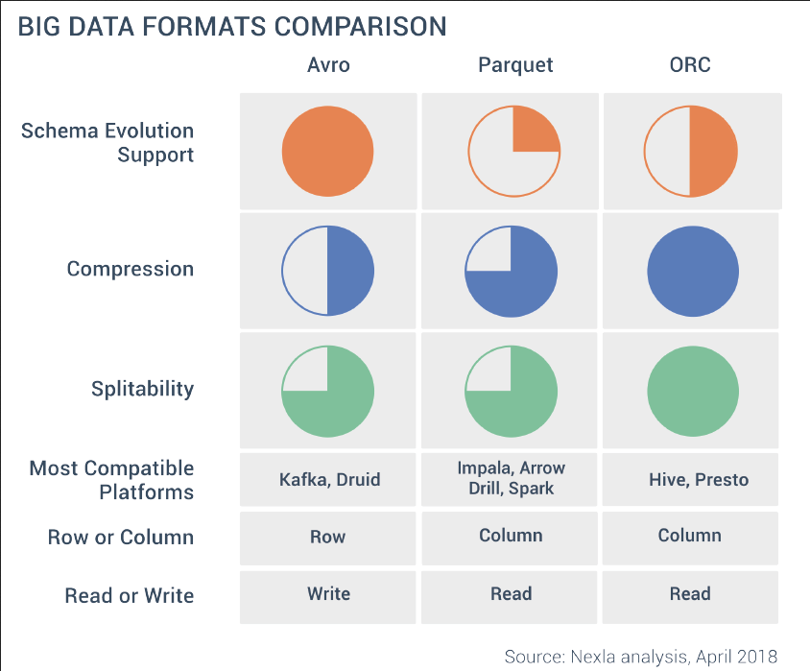
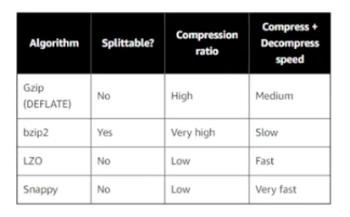
File Formats

Slide 22
SerDes
Data Format | Description | SerDe types supported in Athena
CSV (Comma-Separated Values) | For data in CSV, each line represents a data record, and each record consists of one or more fields, separated by commas. | Use the LazySimpleSerDe for CSV, TSV, and Custom-Delimited Files if your data does not include values enclosed in quotes. Use the OpenCSVSerDe for Processing CSV when your data includes quotes in values, or different separator or escape characters.
TSV (Tab-Separated Values) | For data in TSV, each line represents a data record, and each record consists of one or more fields, separated by tabs. | Use the LazySimpleSerDe for CSV, TSV, and Custom-Delimited Files and specify the separator character as FIELDS TERMINATED BY '\t'.
Custom-Delimited | For data in this format, each line represents a data record, and records are separated by custom delimiters. | Use the LazySimpleSerDe for CSV, TSV, and Custom-Delimited Files and specify custom delimiters.
JSON (JavaScript Object Notation) | For JSON data, each line represents a data record, and each record consists of attribute–value pairs and arrays, separated by commas. | Use the Hive JSON SerDe. Use the OpenX JSON SerDe.
Apache Avro | A format for storing data in Hadoop that uses JSON-based schemas for record values. | Use the Avro SerDe.
ORC (Optimized Row Columnar) | A format for optimized columnar storage of Hive data. | Use the ORC SerDe and ZLIB compression.
Apache Parquet | A format for columnar storage of data in Hadoop. | Use the Parquet SerDe and SNAPPY compression.
Logstash logs | A format for storing logs in Logstash. | Use the Grok SerDe.
Apache WebServer logs | A format for storing logs in Apache WebServer. | Use the RegexSerDe for Processing Apache Web Server Logs.
CloudTrail logs | A format for storing logs in CloudTrail.

Slide 23
Schema on Read vs Schema on Write
Schema on Write
Faster results
Structured
Not flexible
SQL
Schema on Read
Slower results
Unstructured
Very Flexible
No DDL - SQL

Slide 24
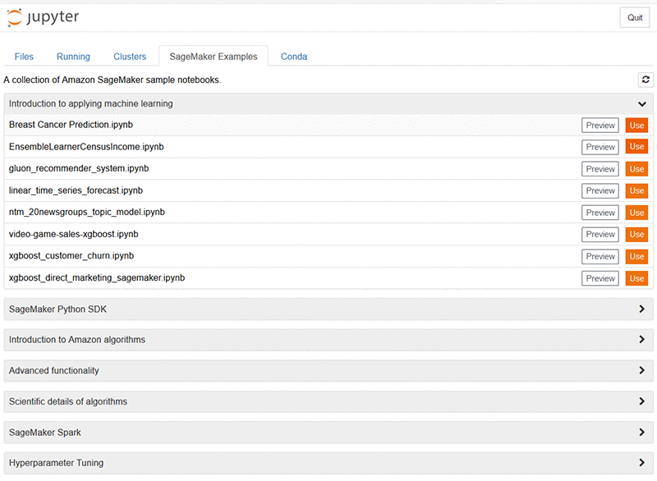
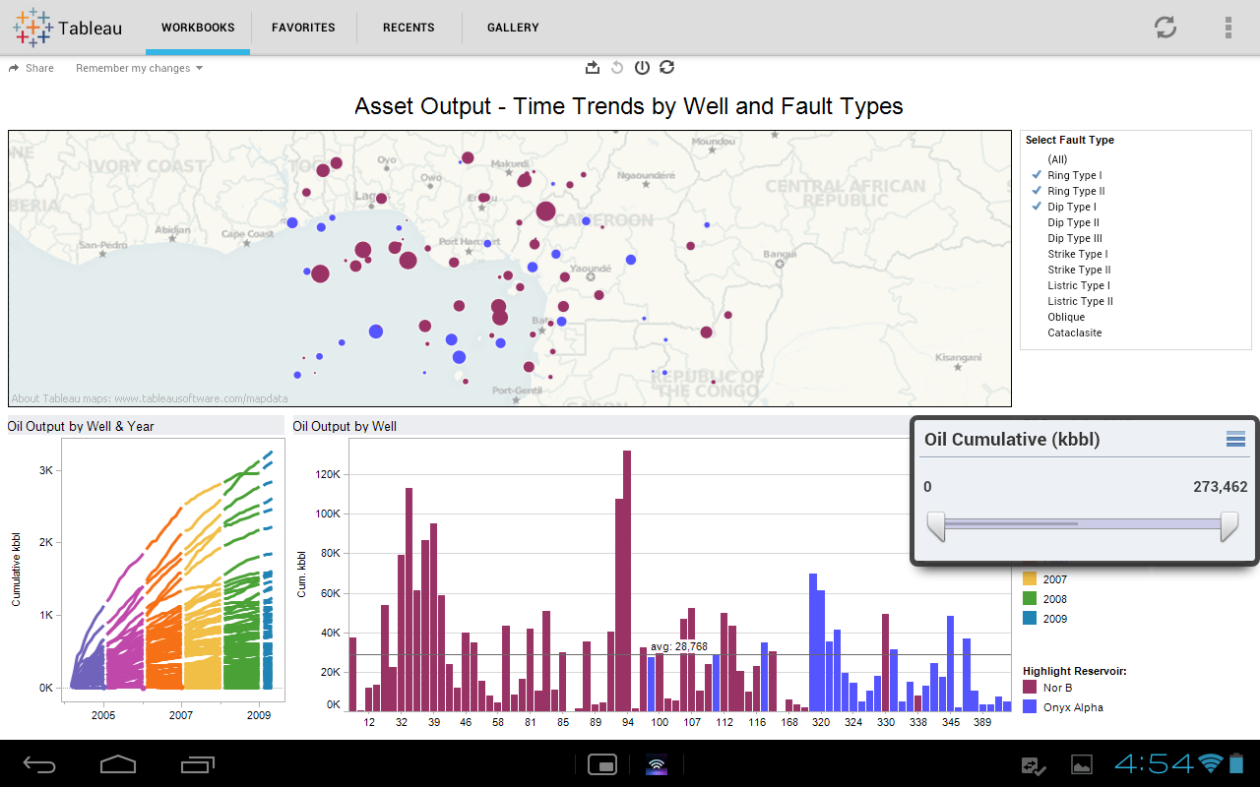
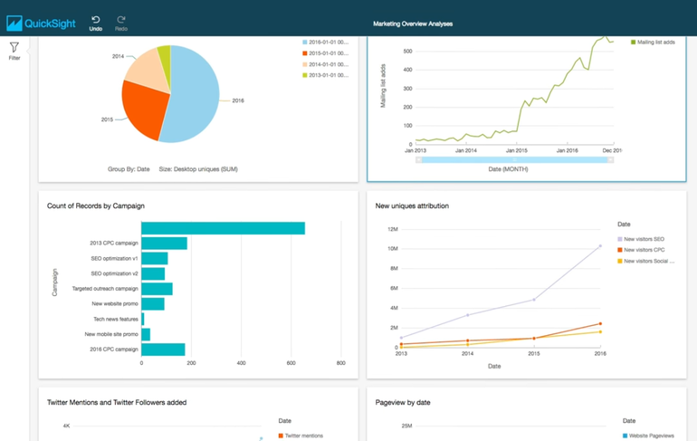
Common Query Output Destinations
SageMaker
Amazon QuickSight

Slide 25
Best Practices & Optimizations
Compress Files (see format specifics)
Partition Information
Use Columnar Format
Consider Extract Step
Frequently Used Athena Queries

Slide 26
Comparison to Other Solutions
Spark
Presto
Airflow
Flink
Kafka
NiFi
CloverETL
Talend
Ab Initio
Attunity
Informatica
Pentaho
SSIS
Oracle GoldenGate
S3 Select
Data Pipeline
Hive
EMR – Sqoop
AWS Batch
AWS SWF
AWS Step Functions
Redshift Spectrum
SnowFlake
Google BigQuery
Google Dataflow
Azure ETL
Datapine
https://github.com/pawl/awesome-etl

Slide 27
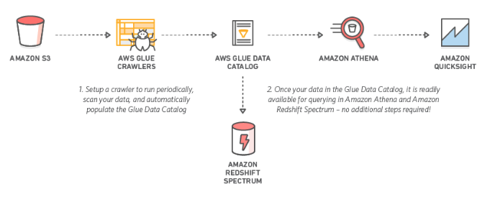
Simple Examples

Slide 28
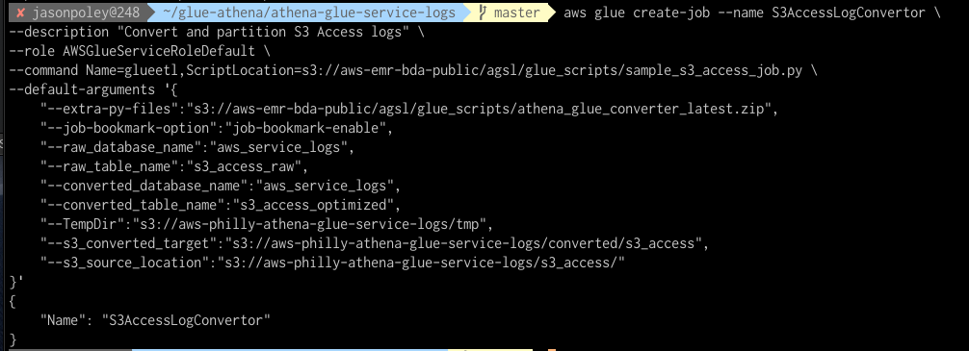
AWS Use Cases
VPC Flow Logs Capture
Cloudtrail with S3 Object Lock
AWS Config Logs
AWS Macie Logs
WebLogs
AWS Billing Data
CloudWatch Log Data
https://aws.amazon.com/blogs/big-data/easily-query-aws-service-logs-using-amazon-athena/

Slide 29
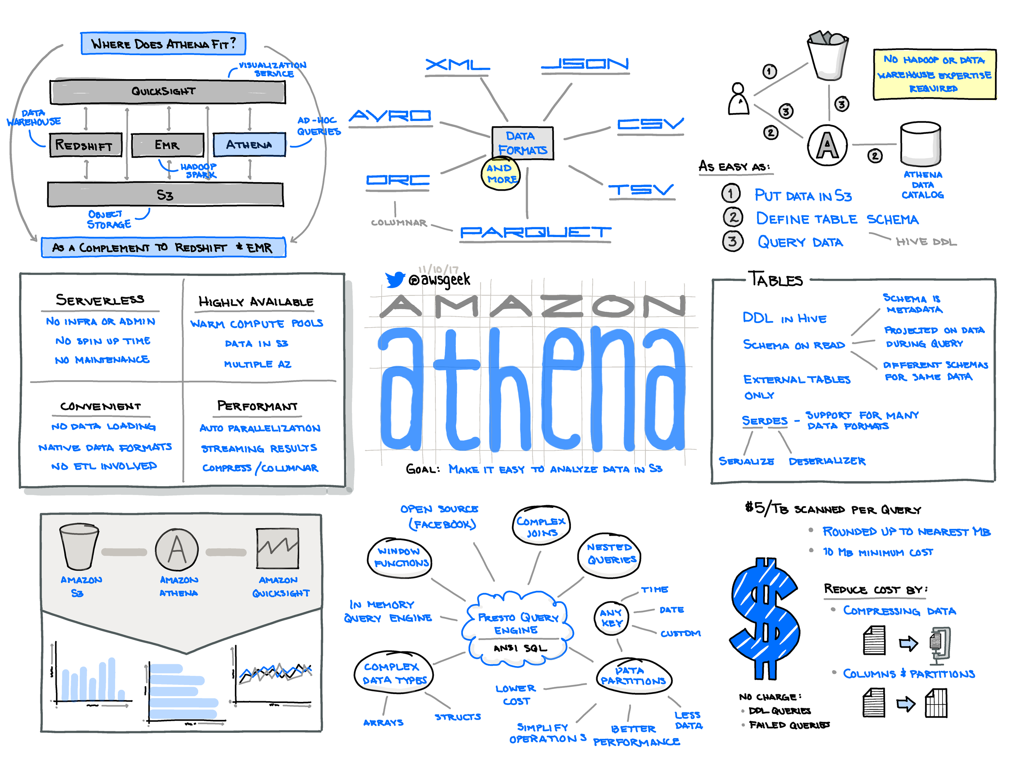

Slide 30
Where to go next?
Data Sources
538 - https://github.com/fivethirtyeight/data
AWS Registry of Open Data - https://registry.opendata.aws/
Google Open Datasets - https://cloud.google.com/public-datasets/
Blog Posts
https://aws.amazon.com/blogs/big-data/tag/aws-glue/
https://aws.amazon.com/blogs/big-data/tag/amazon-athena/
AWS Sample Code -
Glue - https://github.com/aws-samples/aws-glue-samples
https://docs.aws.amazon.com/glue/latest/dg/aws-glue-programming-python-samples-legislators.html

